Slide 1
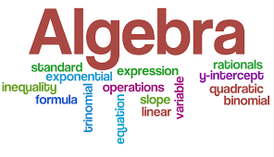
Richmond Hill K8 School
Mr. Jabal M. Moss
Enhanced Algebra & Math 8
2023-2024
Room 726

Slide 2
Welcome to 8th Grade with Mr. Moss!
My name is Jabal M. Moss. I will be teaching Enhanced Algebra and Math 8 for the 2023-2024. I am excited to be a member of the village that will help your child to receive a high-quality education, be engaged in learning, and transformed to optimal success.
8th grade is a year of transformation for students and because of that, “preparation and transformation happens here” is the theme for 8th grade this school year. I am hoping that each student transforms into the person that they desire to be. I plan to do all that I can to make sure that transformation takes place in a clean, conducive, healthy, and inspiring learning environment. It is my goal to not only teach the students but give the students the tools necessary to be who they are and all that they can be.

Slide 3
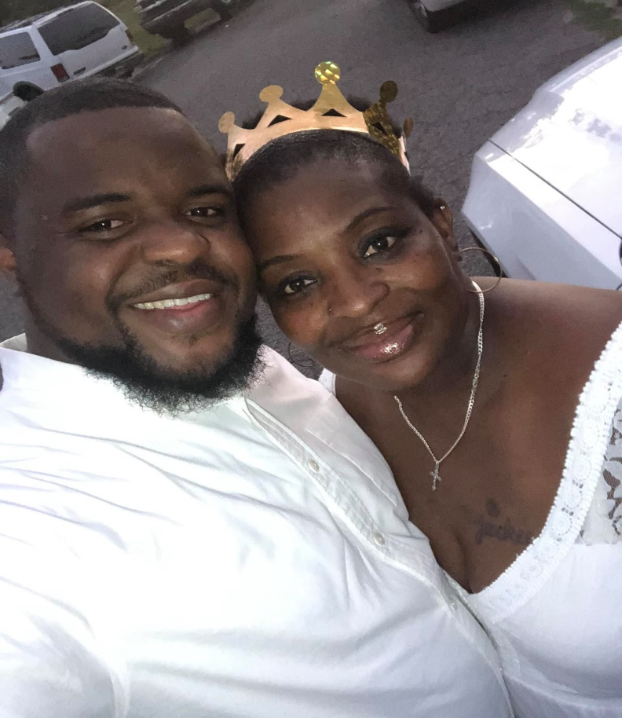
About Your Teacher
Jabal M. Moss is a native of Augusta, Georgia and the son to Ms. Jacquelyn Terry. He graduated from Cross Creek High School in 2009. After graduating, he attended Paine College, Georgia Southern University, and Webster University. He is a proud member of Beulah Grove Baptist Church and loves traveling and spending time with family and friends.

Slide 4
8th Grade Supply List
(1) 3-inch 3-ring binder
(1) 2-inch 3-ring binder
Binder Dividers
Pencils (Mechanical Pencils Preferred)
Highlighters
Loose Leaf Paper
Coloring Utensils (crayons, color pencils, or markers)
Kleenex
Large Bottle of Hand Sanitizer
Clorox Wipes
Earbuds or Headphones

Slide 5
My Class Website Will Provide…
Weekly Lesson Plans (WAG)
Class Syllabi and Supply List
Contact Information
Additional Information and Announcements

Slide 6
2023-2024 Teaching Schedule
8th Grade - Moss
TIME | TOTAL MINS. | SUBJECT
8:45 – 9:15 | 30 min | Breakfast/HR/Review
9:15 – 9:30 | 15 min | Morning Announcement/Dress Code/Power-Off/Attendance
9:30 – 10:00 | 30 min | Intervention
10:10 – 11:25 | 75 min | Enrichment
11:30 – 11:55 | 25 min | Academic Block 1 (Enhanced Algebra)
11:55 – 12:25 | 30 min | Lunch
12:25 -1:00 | 35 min | Academic Block 1 Con’t. (Enhanced Algebra)
1:05 – 2:00 | 55 min | Academic Block 2 (Math 8)
2:05 - 3:00 | 55 min | Academic Block 3 (Math 8)
3:05 – 4:00 | 55 min | Academic Block 4 (Math 8)
Intervention Schedule: M – iReady Reading; Tu – iReady Math; W- iReady; Th – ST MATH; F – ST MATH

Slide 7
RCSS Learning Platforms

Slide 8
Contact Information
E-mail: mossja1@boe.richmond.k12.ga.us
Phone: (706) 796-4944 (School)
(762) 233- 5874 (School Cell)
Remind: Text @math8mossj to 81010 to access the 2023-2024 class remind group for Math 8 and @eawithmoss to 81010 to access the 2023-2024 to access the Enhanced Algebra remind group.

